Slide 1
DEAD STOCK MANAGEMENT SYSTEM
BY
DEVIKA C (221801009)
KEERTHIKA P (221801027)
LAVANYA S (221801028)

Slide 2
Problem Statement
Managing non-moving or obsolete inventory is a major challenge for organizations, often leading to resource wastage, operational inefficiencies, and increased administrative burden. Without a proper system in place, tracking and identifying dead stock becomes difficult, resulting in cluttered storage, poor utilization of warehouse space, and delays in decision-making. The lack of real-time visibility, automated alerts, and proper classification further aggravates the issue, making it harder to streamline inventory control. This inefficiency not only increases costs but also hampers procurement planning and overall supply chain performance

Slide 3
objectives
Real-time tracking and management of pharmaceutical orders and warehouse inventory.
Barcode-based automation for scanning and updating stock and batch information seamlessly.
Predictive analytics using logistic regression to anticipate medicine expiry and generate alerts.
E-commerce integration with platforms like Shopify to enable clearance of near-expiry drugs via discounted online sales.

Slide 4
ABSTRACT
The Pharmacy Dead Stock Management System is a smart web-based tool that reduces medicine wastage by predicting expiry risks using AI models. It tracks inventory in real-time, alerts managers before medicines expire, and supports efficient stock movement across locations. The system includes modules for warehouse and order management, barcode scanning, and integrated reporting. It alerts via Expiry Calander for critical stock and integrates with platforms like Shopify .Overall, it boosts efficiency, cuts losses, and ensures better medicine availability.

Slide 5
Exisiting System
Manual Inventory Management: Most pharmacies still rely on manual or semi-digital methods for tracking inventory, which leads to delays, human errors, and inaccurate stock records.
No Expiry Prediction: Traditional systems do not predict or notify about upcoming medicine expiries, resulting in wastage and financial loss due to unused or expired stock.
Lack of Integration: There is no direct integration with e-commerce platforms, making it difficult to manage clearance of near-expiry stock efficiently.
Poor Reporting Mechanism: Current systems lack intuitive dashboards, real-time insights, and comprehensive analytics required for proactive decision-making.

Slide 6
Drawback of Existing System
Expiry Alerts: Medicines often expire unnoticed due to the absence of automated expiry notifications.
Manual Inventory Tracking: Increases the chance of errors and delays in stock updates.
Lack of Integration: Inventory, warehouse, and sales systems operate independently without synchronization.
No Online Sales Support: There is no provision for selling near-expiry stock to customers through an e-commerce platform.
Lack of Real-Time Updates: Inventory and order status are not updated in real-time, leading to poor visibility of stock availability and warehouse movement.

Slide 7
Proposed System
Barcode-Based Tracking: Integrates barcode scanning to automatically capture and manage product details, including batch numbers and expiry dates.
AI-Powered Expiry Prediction: Uses logistic regression to classify medicines into expiry risk levels and sends real-time alerts to prevent wastage.
Centralized Inventory & Warehouse Management: Provides a unified platform for adding, updating, and monitoring stock across warehouse and inventory modules.
Shopify Integration for Quick Clearance: Seamlessly connects with Shopify to list near-expiry medicines at discounted rates, reducing dead stock and maximizing recovery.

Slide 8
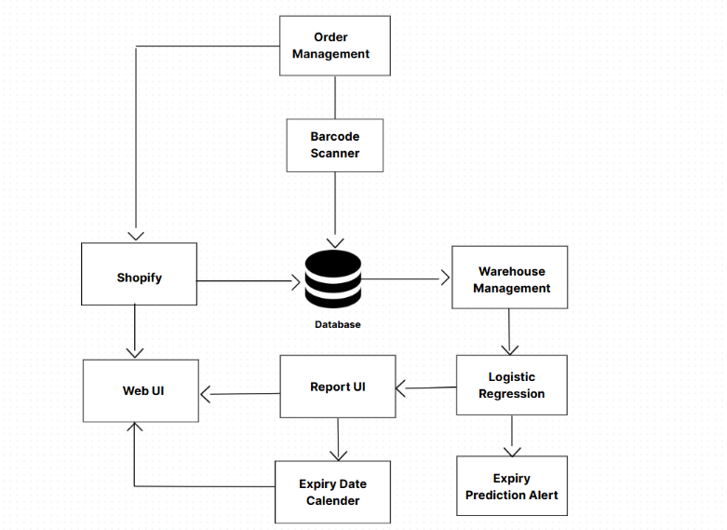
System Architecture

Slide 9
Order Management System
The Order Management Module in the Pharmacy Dead Stock Management System is designed to handle all inventory transactions efficiently, from order placement to fulfillment and stock updates. It supports CRUD operations (Create, Read, Update, Delete) for seamless order processing, allowing pharmacies to manage stock, track sales, and ensure real-time updates. The module follows a structured workflow: orders are placed manually or via Shopify Integration, stock availability is validated, barcode scanning via QuaggaJS ensures accurate stock tracking. Automatic alerts notify users about low stock.

Slide 10
Warehouse System
The proposed warehouse management system leverages AI-driven predictive analytics to enhance inventory tracking, expiry risk assessment, and stock movement classification in pharmaceutical warehouses. . To address these challenges, the system utilizes logistic regression to predict the expiry risk of medicines. Furthermore, an Expiry Calendar is integrated to provide a visual representation of stock nearing expiration, categorizing medicines into Red Zone (critical expiry risk). the proposed warehouse management solution minimizes dead stock, improves inventory turnover, and prevents medicine wastage.

Slide 11
Bar code System
By embedding barcodes on medicine packaging, pharmacies and warehouses can automate stock tracking, reduce manual errors, and improve operational efficiency. Each medicine is assigned a unique barcode that encodes essential details such as medicine ID, name, batch number, expiry date, supplier details, and stock quantity. Using barcode scanners or mobile applications, users can instantly retrieve or update product information by scanning the barcode. Integrating barcode technology with a warehouse management system (WMS) or an online sales platform further enhances supply chain efficiency, allowing seamless product identification and traceability.

Slide 12
Shopify integration
Direct Customer Access to Products When users click the Shopify button on the website, they are redirected to an online store where they can view and purchase available pharmaceutical products directly, including discounted near-expiry medicines.
Smooth and Secure Shopping Experiece Customers can browse products, add items to cart, and checkout securely through the Shopify platform, ensuring a trusted e-commerce experience with proper payment gateways, order tracking, and delivery services.
Inventory and Sales Synchronization All products listed on Shopify are synchronized with the warehouse database in real time, meaning available stock, pricing, and expiry information are kept up-to-date, avoiding overselling and improving customer satisfaction.

Slide 13
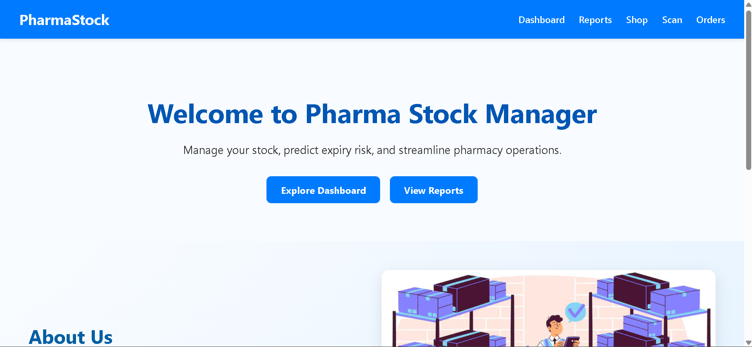
OUTPUT

Slide 14
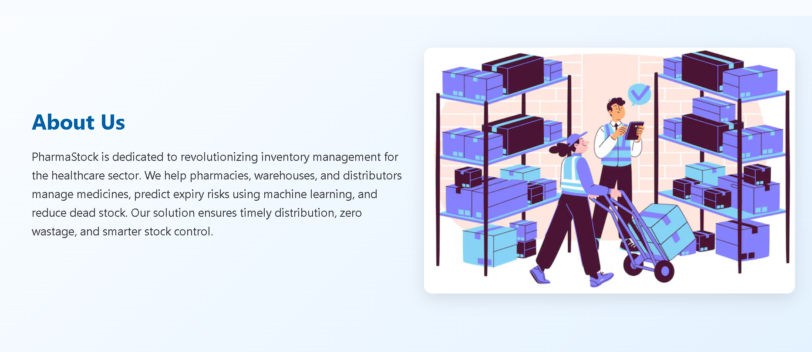
OUTPUT

Slide 15
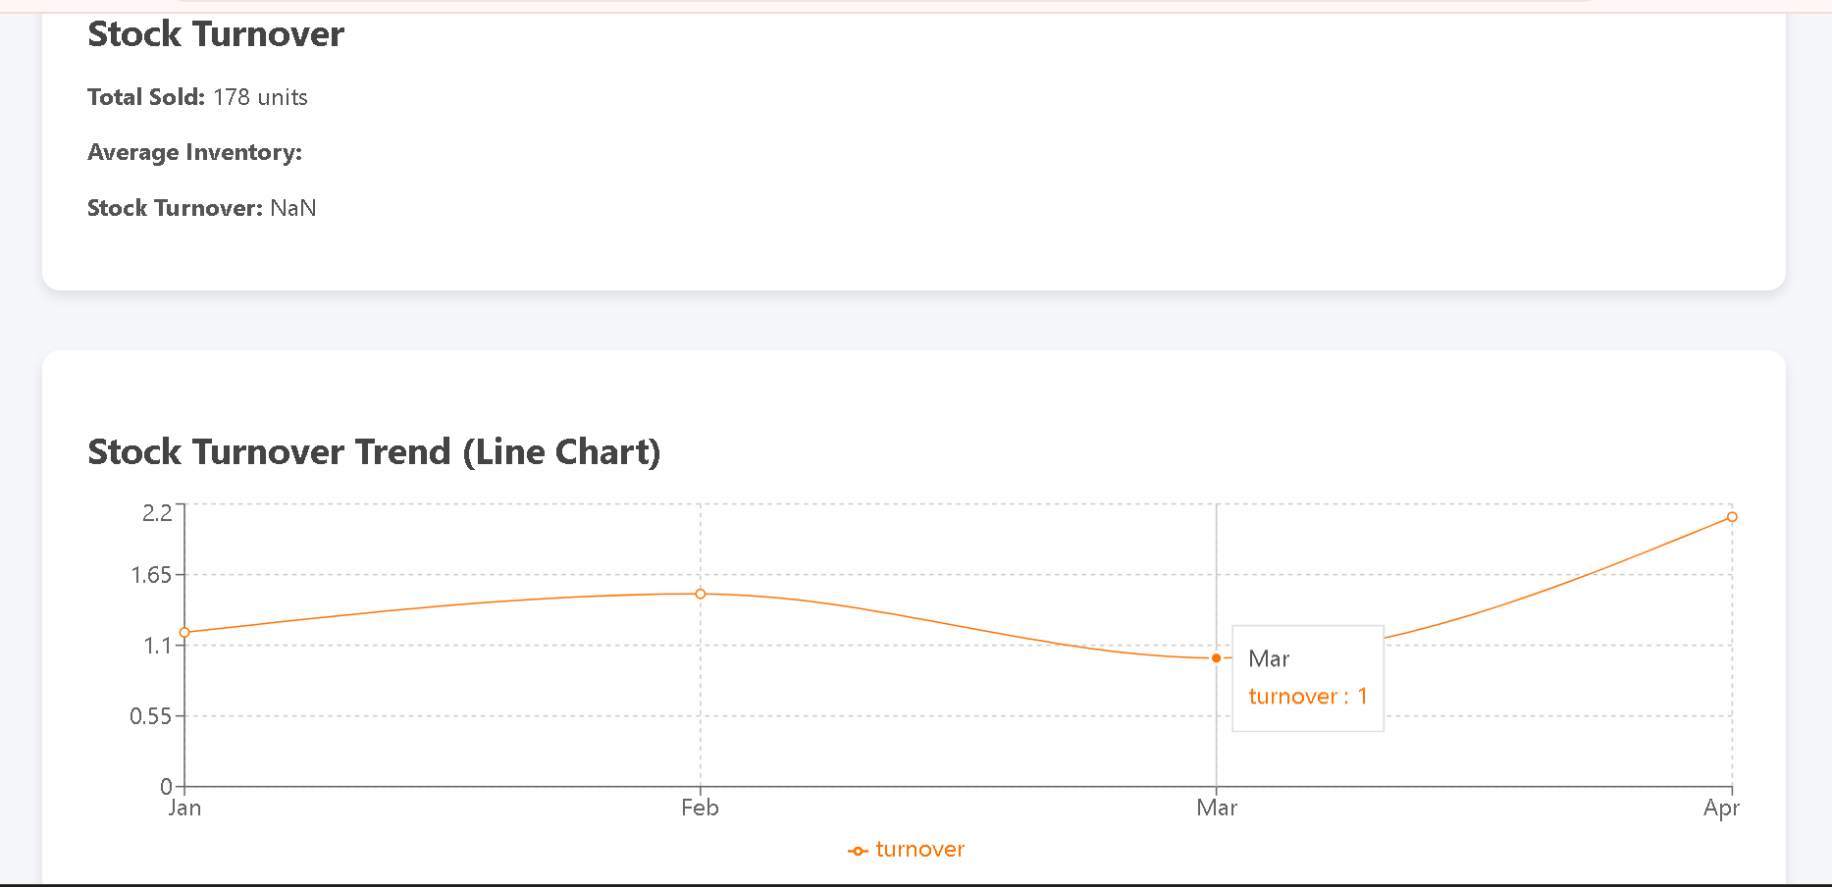
OUTPUT

Slide 16
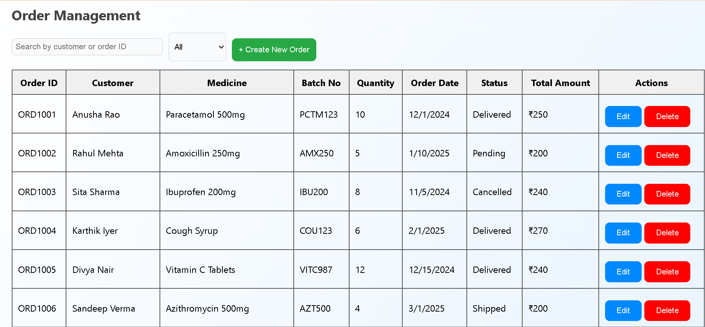
OUTPUT

Slide 17
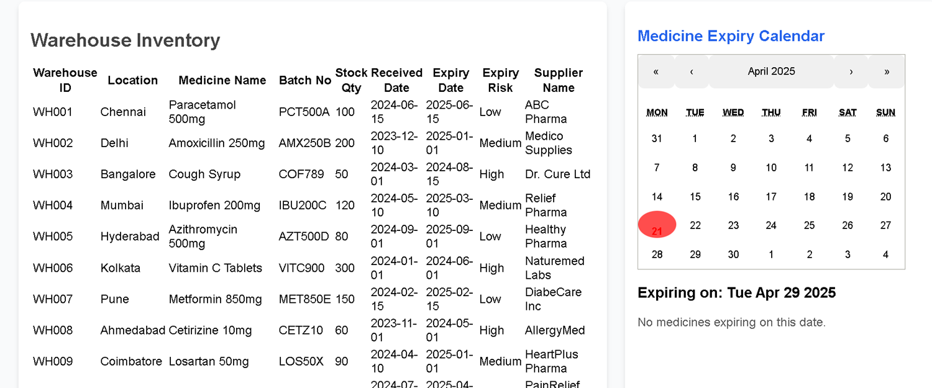
OUTPUT

Slide 18
THANK YOU

